Slide 1
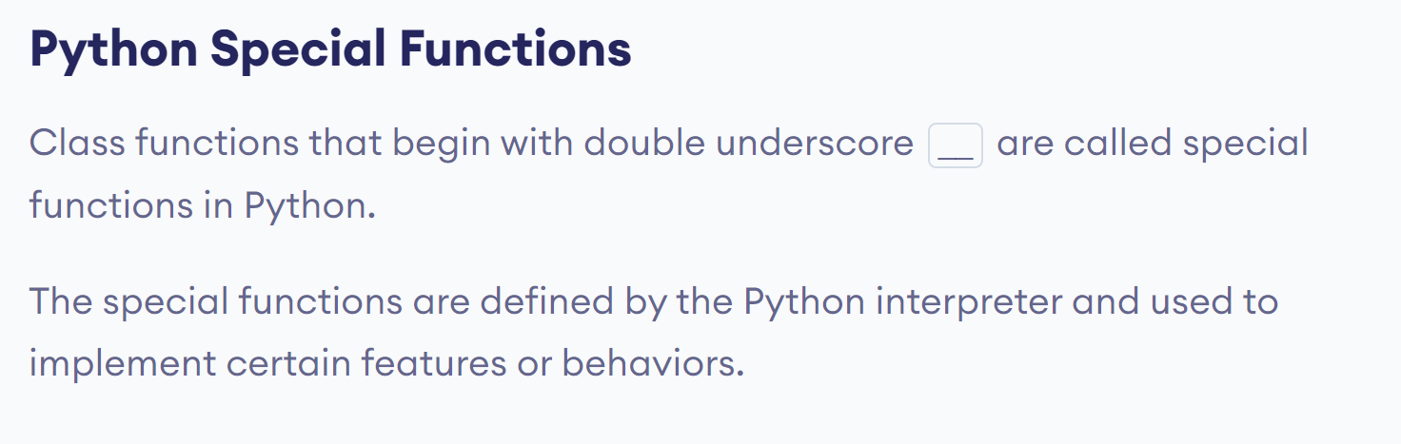
Python Operator Overloading
In Python, we can change the way operators work for user-defined types.
For example, the + operator will perform arithmetic addition on two numbers, merge two lists, or concatenate two strings.
This feature in Python that allows the same operator to have different meaning according to the context is called operator overloading.

Slide 2

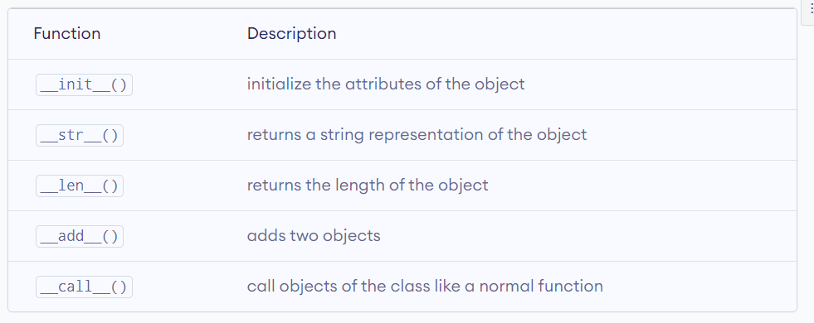

Slide 3
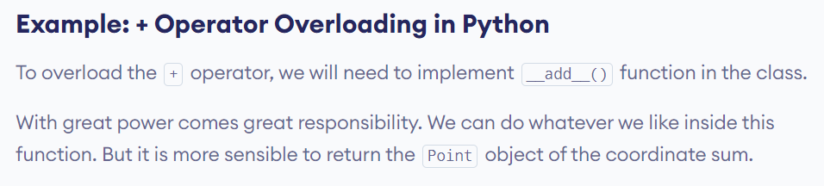
class Point:
def __init__(self, x=0, y=0):
self.x = x
self.y = y
def __str__(self):
return "({0},{1})".format(self.x, self.y)
def __add__(self, other):
x = self.x + other.x
y = self.y + other.y
return Point(x, y)
p1 = Point(1, 2)
p2 = Point(2, 3)
print(p1+p2)
# Output: (3,5)

Slide 4
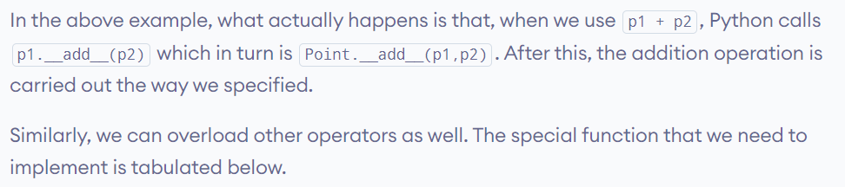
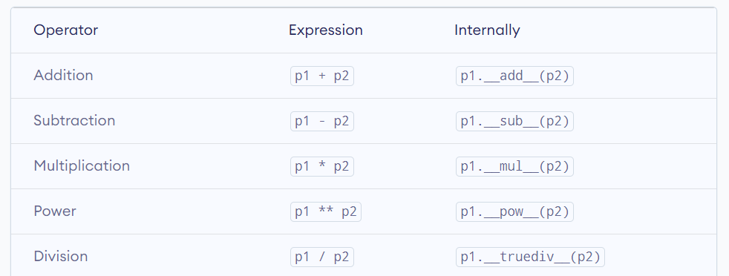

Slide 5
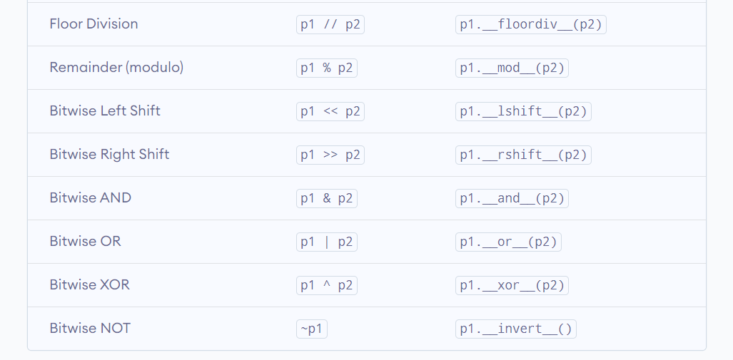

Slide 6
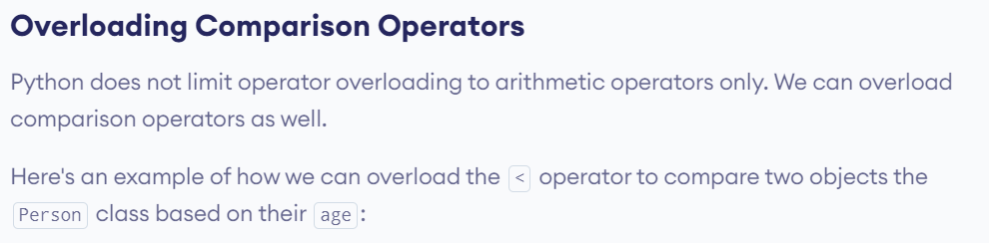
class Person:
def __init__(self, name, age):
self.name = name
self.age = age
# overload < operator
def __lt__(self, other):
return self.age < other.age
p1 = Person("Alice", 20)
p2 = Person("Bob", 30)
print(p1 < p2) # prints True
print(p2 < p1) # prints False
Here, __lt__() overloads the < operator to compare the age attribute of two objects.
The __lt__() method returns,
True - if the first object's age is less than the second object's age
False - if the first object's age is greater than the second object's age

Slide 7
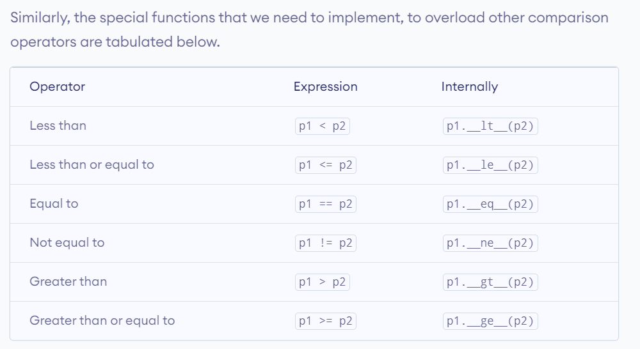

Slide 8
